Slide 1

PROJECT 3 Group4
How countries' macroeconomic indicators affect Immigration to Canada

Slide 2
OBJECTIVE
How a country’s macroeconomic indicators affects Immigration to Canada
To visualize and explore different country macroeconomic indicators and assess whether or not it is a good indicator for immigration to Canada
To identify trends and correlations between economic strength (measured by different indicators) and immigration flows
To present insights visually and dynamically for better interpretation and decision-making.

Slide 3













API
ETL
Application services x6
API
User interface
Analysis & visualizations

Slide 4
DATA COLLECTION
Immigration data :
source : Immigration, refugees and citizenship of Canada
type : CSV file
Access : https://www.ircc.canada.ca/opendata-donneesouvertes/data/ODP-PR-Citz.csv
Macroeconomic data :
source : World bank
type : API
Access : https://api.worldbank.org/v2/country/XXX/indicator/XX.XXX.XXX.XX?date=XXXX:XXXX&format=json
We need an intermediate data to link the country name (in immigration data) and country code (used by the API)
type : API
Access : https://api.worldbank.org/v2/country?format=json

Slide 5
DATA CLEANING AND TRANSFORMATION
Merge dataframes
rename / drop columns
data type conversion
replace empty values / NAN values
replace countries name : the names used in the 2 datasets do not match
identify the mismatch and manually create a mapping dictionary
replace 78 countries to be in line with World bank
map months to get the numeric value (exp : mars : 3, apr : 4)
reset index
group by function

Slide 6
DATA CLEANING AND TRANSFORMATION
Outputs
csv : immigrants_by_country_monthly:
immigration statistics by country and by month from 2015 to 2024
(19,695 rows)
csv : macro_economic_data:
X selected indicators for each country and each year from 2015 to 2024
(38,557 rows)
csv : Countries_list_UN_referential
Gives additional information (region, coordinates, capital) that can help to additional analysis
218 rows

Slide 7
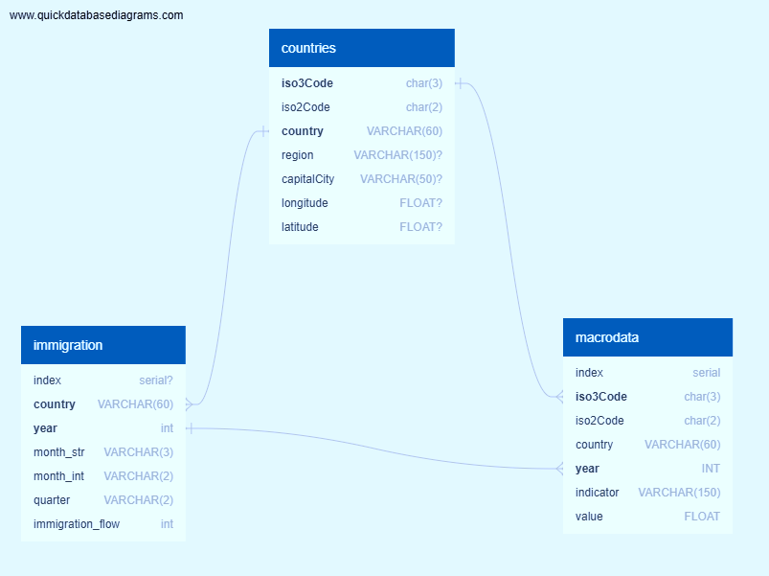
DATA BASE CREATION
Type : sqlite
Created by : SQLAlechemy
Source : csv files
declarative_base method
Output : 3 tables
countries, immigration, microdata

Slide 8
FLASK API
use of “automap_base” method
create a server : http://127.0.0.1:5000
it describes the API’s possibilities
Create 6 routes to extract data

Slide 9
ANALYSIS AND VISUALIZATION'S
Create a DF that collect the linear regression result for all indicators against (immigration flow / total population)
Calculate average of indicators
Use pivot function
Rename columns
Use functions to calculate and drop outliers, to calculate regressions and compile the result

Slide 10
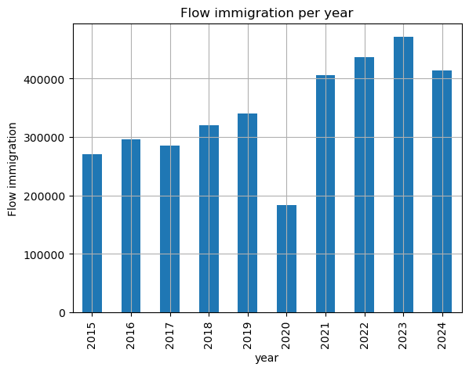
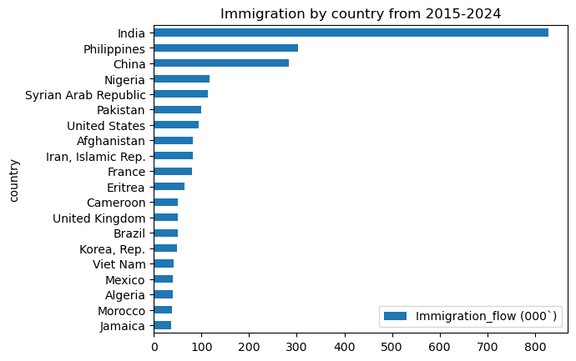
ANALYSIS AND VISUALIZATION'S
The data can be used to generate several visualizations
Available as png, gif, files via pandas.plot
Available as HTML files

Slide 11
ANALYSIS AND VISUALIZATION'S
Create a race bar_chart
Library : bar_chart_race (pip install bar_chart_race)
Source : https://github.com/dexplo/bar_chart_race
documentation : https://www.dexplo.org/bar_chart_race/tutorial/

Slide 12
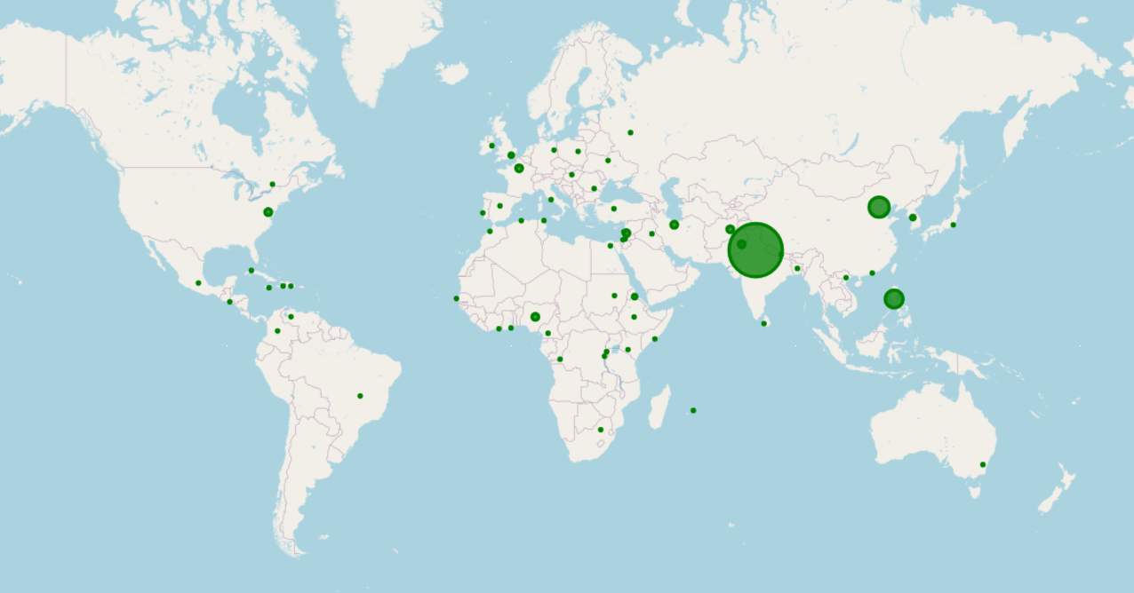
ANALYSIS AND VISUALIZATION'S
Leaflet immigration by country
Source route : http://127.0.0.1:5000/api/v0.1/immigation_flow_per_country

